Slide 1
Astra Data Scientist Bootcamp Technical Test
Business Section Report
Farid Lisniawan Muzakki

Slide 2
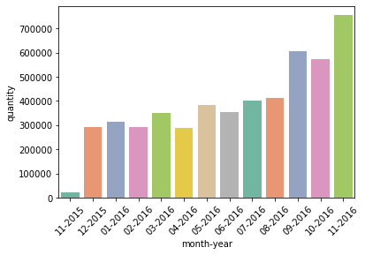
Monthly Transactions
The quantity of total product sold per month is increasing over month.

Slide 3
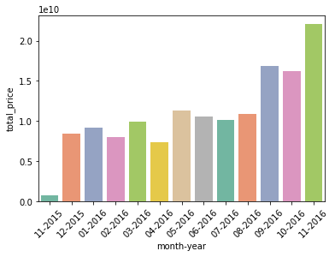
Monthly Transactions
Total price was calculated by multiplying unit price to quantity.
The total price for all transactions per month is increasing over month.

Slide 4
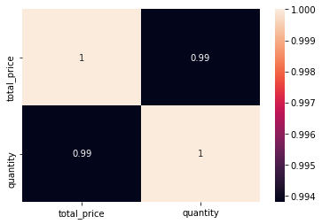
Monthly Transactions
Using Spearman’s Rank-Order correlation, can be know that quantity and total price value have an almost perfect correlation.
If the quantity of total product sold is increasing, the total transactions for all products will increase too, and vice versa.

Slide 5
Metrics/Variable
There are two types of variable that we should look at.
The first type is space-time variable, consisting of location variable and time variable.
Location variable is used to determine the best city/place to do the business.
Time variable is used to find a pattern of the business at a certain period.

Slide 6
Metrics/Variable
The second type is economy variable, consisting of producer variable, customer variable, and product variable.
Producer variable is used to make a database which consist potential producers that can support the business.
Customer variable is used to make a database which consist potential customers that can support the business.
Product variable is used to determine the best product to offer to the consumers.

Slide 7
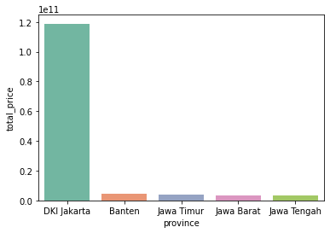
Exploring Data
From the data, can be found that DKI Jakarta province has the highest total transactions price for all transactions, followed by Banten, Jawa Timur, Jawa Barat, and Jawa Tengah provinces.

Slide 8
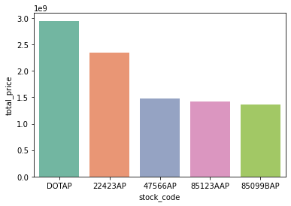
Exploring Data
From the data, can be found that product with stock code DOTAP has the highest total transactions price, followed by product with stock code 22423AP, 47566AP, 85123AAP, and 85099BAP.

Slide 9
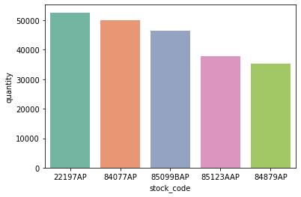
Exploring Data
From the data, can be found that product with stock code 22197AP is the most sold product, followed by product with stock code 84077AP, 85099BAP, 85123AAP, and 84879AP.
A product with high sold quantity not necessarily has high total transaction price.

Slide 10
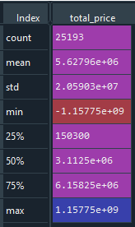
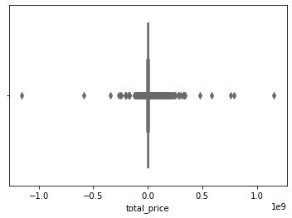
Exploring Data
From the data, can be found there are lots of outlier invoices which have total transactions price much higher than usual invoice.

Slide 11
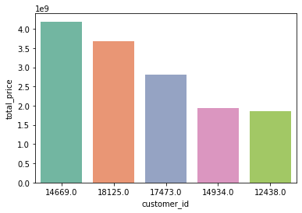
Exploring Data
From the data, can be found that customer with id 14669 has the highest total transaction price than other customers, followed by customer with id 18125, 17473, 14934, and 12438.

Slide 12
Action Plans
Make new marketing strategy to reach more customers in Banten and Jawa Timur province (the second and third provinces with highest total transactions price). The total transactions price differences between DKI Jakarta and these provinces is very high. Sales in these provinces have high chance to be improved.
Optimalize the most sold product production so it can produce more price and profit. The most sold product not include in the five highest total transactions price. Potential new profits for this product is still high.

Slide 13
Action Plans
Make new marketing and sales strategy for products that are included in the five highest total transactions price. The more the number of sales for these products, the more price and profit that company will get.

Slide 14
Thank You!

